Slide 1

Algorithms and Flowcharts

Slide 2
Computers and Logic
Logic is the study of various principles or tools of correct reasoning and of the application of those tools in solving problems.
To complete a computer task, all of the reasoning required to perform that task must be done by the programmer and entered into the computer in the form of a computer program.
a good understanding of logic is valuable in helping the programmer to avoid programming errors and to produce programs that run as intended.

Slide 3
Computers and Logic
The tools of logic are very helpful in analyzing, or breaking down, such problems into simple steps and simple instructions.
This analysis is important because computers can understand only very simple instructions.

Slide 4
Understanding the Programming Process
A programmer's job involves writing instructions and can be broken down into six programming steps :
Understand the problem.
Plan the logic.
Code the program.
Translate the program into machine language.
Test the program.
Put the program into production.

Slide 5
Understanding the Programming Process
Understanding the Problem: a Professional computer programmers write programs to satisfy the needs of others.
Note: Really understanding the problem may be one of the most difficult aspects of programming.
Code the Program : The heart of the programming process lies in planning the program's logic.

Slide 6
Understanding the Programming Process
During this phase of the programming process, the programmer plans the steps to the program, deciding what steps to include and how to order them.
The two most common tools are flowcharts and pseudocode. Both tools involve writing the steps of the program in English.
Note: " An algorithm is the sequence of steps necessary to solve any problem.”

Slide 7
Understanding the Programming Process
Code the Program : write the program in one of more than 400 programming languages.
Translate the Program into Machine Language:
Test the Program : Selecting test data to test program and ensure that the program is free of syntax errors and free of logical errors.
Put the Program into Production :Once the program is tested adequately, it is ready for the organization to use.

Slide 8
Algorithms

Slide 9
Algorithms
Algorithm is a set of rules applied to numbers written in decimal form. The word is derived from the phonetic pronunciation of the last name of Abu Ja'far Mohammed ibn Musa al-Khowarizmi, who was an Arabic mathematician who invented a set of rules for performing the four basic arithmetic operations (addition, multiplication , subtraction, and division) on decimal numbers.

Slide 10
Algorithms
An algorithm is a set of rules or instructions for doing a task or solving a problem.
It is a step-by-step series of instructions wherein each successive step is determined by the outcome of previous steps.
A computer program is simply an algorithm for a computer that is written in a programming language.
These algorithms can be designed though the use of flowcharts or pseudocode.

Slide 11
Algorithms
Both the pseudocode and flowchart in algorithm should always have a Start step at the beginning and at least one Stop step at the end.

Slide 12
Flowcharts

Slide 13
Flowcharts
Flowcharts are graphic representations of algorithms. they form an intermediate step between human understanding of the task to be accomplished and the coded program that directs a computer to complete the various steps of the task.
A flowchart is a diagram made up of boxes, diamonds and other shapes, connected by arrows - each shape represents a step in the process, and the arrows show the order in which they occur.

Slide 14
Flowcharts
Flowcharting combines symbols and flowlines , to show figuratively the operation of an algorithm.
Flowcharts be essential in developing and understanding the task.

Slide 15
Standard Symbols used in Flowcharts

Slide 16

The Terminal Symbol
The terminal symbol indicates the beginning and the end of processing. It contains the word START, STOP, or END.
It represented by rounded rectangles .

Slide 17
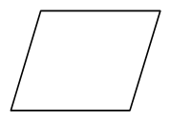
The Input / Output Symbol
The input/output symbol (or I/O symbol) indicates that the computer is to obtain new data or to record the results of computations.
This symbol often contains directions to read records or to print report lines.
It represented by parallelograms.

Slide 18
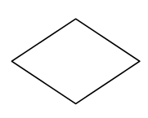
The Decision Symbol
The decision symbol represents a branch in the flow of a program; it must contain directions that indicate which branch to follow. It represented by Diamond .
This symbol usually contains a question, and each of its branches is labeled with an answer.

Slide 19
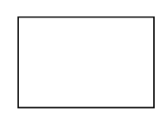
The Process Symbol
The process symbol contains instructions that are not represented by other symbols.
Process symbols usually contain directions for calculations or for the storage of data.
It represented by rectangles.

Slide 20

Flow direction lines
Flow direction lines indicate the flow of the program.

Slide 21
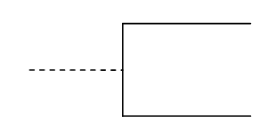
Comments
The comment or annotation symbol is used to annotate other entries.
The dashed line indicates the position of the comment.

Slide 22

The Connector Symbol
The connector is used to join areas of a flowchart, in the other word allows you to connect two flowchart segments.
A connector represented by a Small Circle .
The connector is used only when points to be joined occur on the same page.

Slide 23
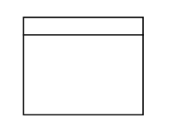
The Striped Symbol
The striped symbol is used to represent a predefined process (or series of operations) when the flowcharts that define the process are included with the current set of flowcharts.

Slide 24
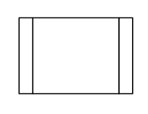
The Predefined Process Symbol
The predefined process symbol or Model symbol is used to represent a predefined process when the flowcharts that define the process are not included with the current set of flowcharts.
Example:
START
Read Input.
Call calc_pay function.
Display results.
END

Slide 25

The off-page Connector Symbol
The off-page connector is used to join areas of a flowchart when the points joined occur on different pages.

Slide 26
Rules for flowcharting

Slide 27
General Rules for flowcharting
All boxes of the flowchart are connected with Arrows. (Not lines)
Flowchart symbols have an entry point on the top of the symbol with no other entry points.
The exit point for all flowchart symbols is on the bottom except for the Decision symbol.
The Decision symbol has two exit points; these can be on the sides or the bottom and one side.

Slide 28
General Rules for flowcharting
Generally a flowchart will flow from top to bottom.
Connectors are used to connect breaks in the flowchart. Examples are:
• From one page to another page.
• From the bottom of the page to the top of the same page.
Subroutines have their own and independent flowcharts.

Slide 29
General Rules for flowcharting
All flow charts start with a Terminal or Predefined Process subroutines symbol.
All flowcharts end with a terminal or a contentious loop.

Slide 30
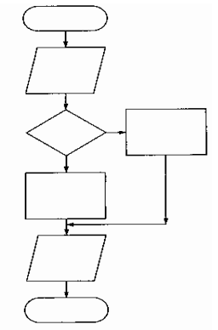
Any program using flowchart would be
Start.
Read some information.
Make a decision.
On the basis of that decision , carry out one process or the other.
Print a result in either case.
Stop.

Slide 31
Four Flowchart Structures
Sequence
Decision
Repetition
Case

Slide 32
Sequence Structure
A series of actions are performed in sequence.

Slide 33
Decision Structure
One of two possible actions is taken, depending on a condition.

Slide 34
Repetition Structure
A repetition structure represents part of the program that repeats. This type of structure is commonly known as a loop.

Slide 35
Repetition Structure
Repetition Structure
Post-Test
Pre-Test

Slide 36
Repetition Structure
In Pre-Test Repetition Structure The condition is tested BEFORE any actions are performed.
In Post-Test Repetition Structure The condition is tested AFTER the actions are performed.
YES
x < y?
Display x
Add1 to x
Display x
Add 1 to x
YES
x < y?

Slide 37
Case Structure
One of several possible actions is taken, depending on the contents of a variable.

Slide 38
Case Structure
Example:
If years employed = 2, bonus is set to 200
If years employed = 3, bonus is set to 400
If years employed = 1, bonus is set to 100
If years employed is any other value, bonus is set to 800
CASE years employed
1
2
3
Other
bonus = 100
bonus = 200
bonus = 400
bonus = 800

Slide 39
Exercises on Flowcharts

Slide 40
Exercise _ 1
Design an Flowchart to convert a temperature in degrees Fahrenheit to degrees Celsius.
Hint: Celsius = 5/9 * (Fahrenheit – 32).
Start
Read Fahrenheit
Celsius = 5/9 * (Fahrenheit – 32)
Output
Celsius
End

Slide 41
Exercise _ 2
Design an Flowchart that accepts two numbers and computes their sum, difference, product, and quotient.
Start
Read Num1
Read Num2
Sum = Num1 +Num2
Difference = Num1 - Num2
Product = Num1 * Num2
Quotient = Num1/Num2
Print Sum
Print Difference
Print Product
Print Quotient
END

Slide 42
Exercise _ 3
You work in a store that sells imported fabric. Most of the fabric you sell is measured in square yards, but your customers want to know the equivalent amount in square meters. Design an Flowchart to perform this conversion.
Hint: 1 square meter = 1.198 yards.
Start
Read value in Yard (Y)
Square meter Value (S) = Y/1.198
Output S
END

Slide 43
Exercise _ 4
Design an Flowchart that computes the employee’s gross salary given the hours work and the hourly rate. Assume that 15% of the salary is deducted as taxes.
Start
Read Hours Work (H)
Read Hourly Rate (R)
Gross Salary = H * R
Tax = (15/100) * Gross Salary
Net Salary = Gross Salary - Tax
Print Net Salary
END

Slide 44


Exercise _ 5
Design an Flowchart that computes the distance between two points (X1, Y1) and (X2,Y2).
Hint: Distance =
Start
Read X1
Read X2
Read Y1
Read Y2
Z1 = (x1 – x2)^2
Z2 = (y1 – y2)^2
Distance =
Output Distance
END

Slide 45
Exercise _ 6 _Assignment_ 1
Ann likes to jog in the morning. As she jogs, she counts the number of strides she makes during the first and the last minutes of her jogging. Anne then averages those two and calls this the number of strides she makes in a minute. Design an flowchart that accepts those averages and the total time she spent jogging (in hours and minutes) and then outputs the distance Ann jogged in miles. Assume that Ann’s stride to be 2.5 feet.
Hint: 1 mile has 5280 feet.

Slide 46
Start
Read Average
Read Hours
Read Minutes
Total Minutes = (Hours * 60) + Minutes
Total number of Strides = Total Minutes * Average
Feet Total = Total Strides * 2.5
Miles = Feet Total / 5280
Output Miles
END

Slide 47
Pseudo code
How to write pseudo code

Slide 48
What is a Pseudo code ?
Pseudo code is an approximate language between the natural language and computer code.
Pseudo code is English phrases or lines of statements that used to solve specific problem by using short commends.

Slide 49
Why a Pseudo code called by this name?
Because it is not programming language so, computer didn’t understand this language .
Why a Pseudo code used ?
Because after making pseudo code , its very easy to make code by any programming language .

Slide 50
There are six basic computer operations
A computer can receive information
Read (information from a file)
Get (information from the keyboard)

Slide 51
A computer can put out information
Write (information to a file)
Display (information to the screen)

Slide 52
A computer can perform arithmetic
Use actual mathematical symbols or the words for the symbols
- Add number to total
- total = total + number
Note: you use ( +, -, *, / )
Calculate, Compute also used.

Slide 53
A computer can assign a value to a piece of data
3 cases:
To give data an initial value
Initialize, Set
To assign a value as a result
x = 5 + y
To keep a piece of information
for later use
Save, Store

Slide 54
A computer can compare two piece of information and select one of two alternative actions
IF condition THEN
some action
ELSE
alternative action
ENDIF

Slide 55
A computer can repeat a group of actions.
The Repetition structure can be implemented using :
• Repeat Until Loop.
• The While Loop.
• The For Loop.

Slide 56
The Repeat Until loop, The syntax is
REPEAT
A statement or block of statements
UNTIL a true condition
----------------------
The While loop, The syntax is
WHILE condition (is true)
some action
ENDWHILE
----------------------

Slide 57
The For Until loop, The syntax is
FOR a number of times
some action
ENDFOR

Slide 58
Control Structures or Logical Structures

Slide 59
It is possible to write any computer program by using only three basic control structures:
Sequence,
Selection,
Repetition.

Slide 60
Sequence :
Execution of one step after another. This is represented as a sequence of pseudo- code statements:
Statement 1
Statement 2
Statement 3
Example: Read three numbers
Add three numbers
Display total of three numbers

Slide 61
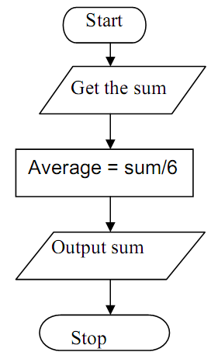
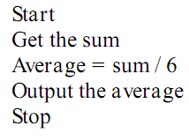
Note : The sequence structure in flowchart is the logical equivalent of a straight line in pseudocode.
Example :

Slide 62
Selection
Presentation of a condition and the choice between two actions,
the choice depending on whether the condition is true or false. In pseudo code, selection is represented by the keywords IF, THEN, ELSE and ENDIF
IF condition p is true THEN
statement(s) in true case
ELSE
statement(s) in false case
ENDIF

Slide 63
Example:
IF student is part-time THEN
Add one to part-time-count
ELSE
Add one to full-time-count
ENDIF

Slide 64
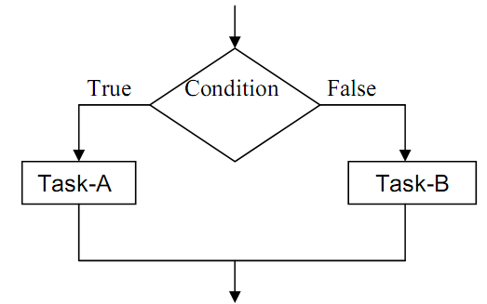
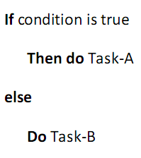
The Selection structure in flowchart and the equivalent of it in pseudocode.

Slide 65
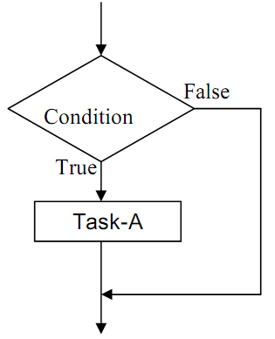

and

Slide 66
Repetition
Presentation of a set of instructions to be performed repeatedly, as long as a condition is true.
WHILE condition p is true
Statement(s) to execute
ENDWHILE
Note:
The condition is tested before any statements are executed.

Slide 67
Example: Set student_total to 0
WHILE student_total < 50
Read student record
Print student name and address
Add 1 to student_total
ENDWHILE
Note:
The variable student_total is initialized before the loop condition is executed.
The student_total variable is incremented within the body of the loop.

Slide 68
Example:
Write a program that obtains two integer numbers from the user. It will print out the sum of those numbers.
Answer is :
Prompt the user to enter the first integer.
Prompt the user to enter a second integer.
Compute the sum of the two user inputs.
Display an output prompt that explains the answer as the sum.
Display the result.

Slide 69
Exercises on Pseudocode

Slide 70
Exercise _ 1
Design an pseudocode to convert a temperature in degrees Fahrenheit to degrees Celsius.
Hint: Celsius = 5/9 * (Fahrenheit – 32).
Answer:
Start.
Get F (Fahrenheit’s degree) .
Celsius = 5/9 * (F – 32).
Output Celsius .
Stop.

Slide 71
Exercise _ 2
Design an pseudocode that accepts two numbers and computes their sum, difference, product, and quotient.
Answer:
Start.
Sum=0, Difference=0 , Product=0 , Quotient = 0 ;
Get the First number.
Get the Second number.
Add First number and Second number to Sum.

Slide 72
Exercise _ 2
Difference=First number - Second number .
Product=First number * Second number .
Quotient = First number / Second number .
Output (Print or display ) Sum.
Output Difference.
Output Product.
Output Quotient .
Stop.

Slide 73
Exercise _ 3
You work in a store that sells imported fabric. Most of the fabric you sell is measured in square yards, but your customers want to know the equivalent amount in square meters. Design an pseudocode to perform this conversion.
Hint: 1 square meter = 1.198 yards.
Answer:
Start.
Get Y (number value in yard).

Slide 74
Exercise _ 3
S (square meter value ) = Y / 1.98 .
Output S.
Stop.

Slide 75
Exercise _ 4
Design an pseudocode that computes the employee’s gross salary given the hours work and the hourly rate. Assume that 15% of the salary is deducted as taxes.
Answer:
Start.
Get H (hours work ).
Get R (hourly rate ) .
Gross Salary = H * R .
Tax = (15/100)* Gross Salary .

Slide 76
Exercise _ 4
Net Salary = Gross Salary - Tax .
Output Net Salary .
Stop.

Slide 77
Exercise _ 5
Design an pseudocode that computes the distance between two points (X1, Y1) and (X2,Y2).
Hint: Distance =
Answer:
Start.
Get X1.
Get X2.
Get Y1.
Get Y2.

Slide 78
Exercise _ 5
Z1 = (X1 – X2)^2
Z2 = (Y1 – Y2 )^2
Distance =
Output Distance.
Stop.

Slide 79
Exercise _ 6
Design an pseudocode and the corresponding flowchart for adding the test scores as given below: 26, 49, 98, 87, 62, 75
Answer of pseudocode:
Start;
Sum = 0 ;
Get Test score _1;
Add Test score _1 to Sum ;
Get Test score _2 ;
Add Test score _2 to Sum ;

Slide 80
Exercise _ 6
Get Test score _3;
Add Test score _3 to Sum ;
Get Test score _4 ;
Add Test score _4 to Sum ;
Get Test score _5 ;
Add Test score _5 to Sum ;
Get Test score _6 ;
Add Test score _6 to Sum ;
Output Sum ;
Stop ;

Slide 81
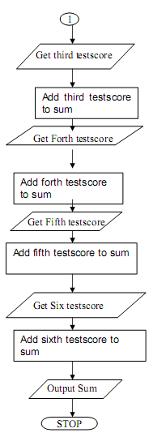
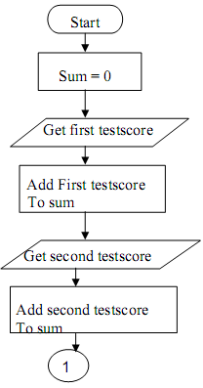
Exercise _ 6
Answer of pseudocode:

Slide 82
Exercise _ 7
The problem with Exercise_6 have some steps appear more than once, i.e. step 5 get second number, step 7, get third number, etc. One could shorten the algorithm or flowchart as follows:
Answer:
Start
Sum = 0
Get Value
Sum = Sum + Value

Slide 83
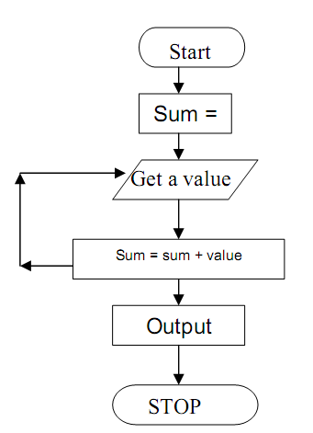
Exercise _ 7
Go to step 3 to get next Value
Output Sum
Stop
Answer of flowchart:

Slide 84
Exercise _ 8
In Exercise_6, step 3 to 5 will be repeated, where a number is obtained and added to the sum . So, we can use repetition structure to represent the answer by adding terminal value to end loop .
Answer of pseudocode:
Start
Sum = 0
Get a value
If the value is equal to –1, go to step 7

Slide 85
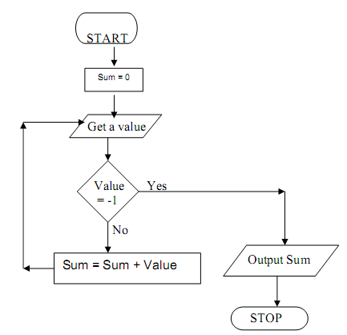
Exercise _ 8
Add to sum ( sum = sum + value)
Go to step 3 to get next Value
Output the sum
Stop
Answer of flowchart:

Slide 86
Exercise _ 9
In Exercise_6, step 3 to 5 will be repeated, by using for loop .
Answer of pseudocode:
Start ;
Count = 6 ;
Sum = 0 ;
For (n = 1, n <= Count, n + 1)
Get number ;
Sum = Sum + number ;
EndFor

Slide 87
Exercise _ 9
Display “ The sum of the numbers is : “ ;
Print Sum ;
Stop ;
START
Count=6
Sum = 0
n = 1
IS n <= Count
Get number
n= n+ 1
Sum = Sum + number
Print Sum
END

Slide 88
Exercise _ 10
Design an algorithm that computes the absolute difference of two values (X and Y), where the difference is (X-Y) or (Y-X), which ever is positive.
Answer of pseudocode:
Start ;
Get x ;
Get Y ;
If ( X > Y )
Diff = X – Y;

Slide 89
Exercise _ 10
Else
Diff = Y - X;
EndIf ;
Print Diff ;
Answer of flowchart:
START
Read X, Y
IS
X>Y
Diff= Y-X
Diff= X-Y
Print Diff
END

Slide 90
Exercise _Assignment_2
Design an algorithm and the corresponding flowchart for finding the sum of the numbers 2, 4, 6, 8, …, n
Using flowcharts, write an algorithm to read 100 numbers and then display the sum.
Write an algorithm to read two numbers then display the largest.
Write an algorithm to read two numbers then display the smallest.

Slide 91
Exercise _Assignment_2
Write an algorithm to read three numbers then display the largest.
Write an algorithm to read 100 numbers then display the largest.
Design an algorithm and the corresponding flowchart for finding the sum of n numbers.

Slide 92

Références
ALGORITHMS, FLOWCHARTS, DATA TYPES AND PSEUDOCODE.
Introduction to Flowcharting A Supplement to Starting Out with C++: From Control Structures to Objects 5th Edition by Tony Gaddis .
http://www.minich.com/education/wyo/stylesheets/pseudocode.htm
Introduction to Computers Lab Handouts .

